Slide 1


Shubham Gupta
20-09-2021

Slide 2

Outline
Executive Summary
Introduction
Methodology
Results
Conclusion
Appendix

Slide 3
Executive Summary
Summary of methodologies
Data collection
Data wrangling
EDA with data visualization
EDA with SQL
Building an interactive map with Folium
Building a Dashboard with Plotly Dash
Predictive analysis (Classification)
Summary of all results
Exploratory data analysis results
Interactive analytics demo in screenshots
Predictive analysis results

Slide 4
Introduction
Project background and context
We predicted if the Falcon 9 first stage will land successfully. SpaceX advertises Falcon 9 rocket launches on its website, with a cost of 62 million dollars; other providers cost upward of 165 million dollars each, much of the savings is because SpaceX can reuse the first stage. Therefore, if we can determine if the first stage will land, we can determine the cost of a launch. This information can be used if an alternate company wants to bid against SpaceX for a rocket launch.
Problems you want to find answers
What influences if the rocket will land successfully?
The effect each relationship with certain rocket variables will impact in determining the success rate of a successful landing.
What conditions does SpaceX have to achieve to get the best results and ensure the best rocket success landing rate.

Slide 5


Slide 6
GridSearchCV
GridSearchCV
Methodology
Executive Summary
Data collection methodology:
SpaceX Rest API
Web Scrapping using Beautiful Soup from Wikipedia
Perform data wrangling
One Hot Encoding data fields for Machine Learning and feature selection
Perform exploratory data analysis (EDA) using visualization and SQL
Perform interactive visual analytics using Folium and Plotly Dash
Perform predictive analysis using classification models
Split data into training and testing set, tune and estimate best model using Gridsearchcv , evaluate classification models to determine best model with highest accuracy.

Slide 7
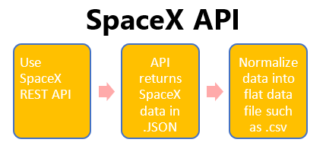
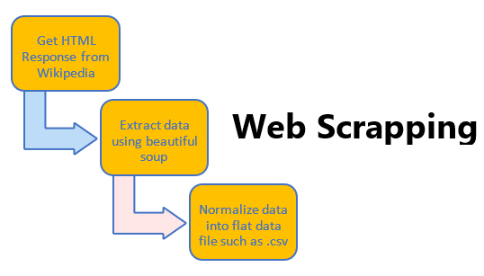
Data Collection
SpaceX launch data that is gathered from the SpaceX REST API.
This API will give us data about launches, including information about the rocket used, payload delivered, launch specifications, landing specifications, and landing outcome.
Our goal is to use this data to predict whether SpaceX will attempt to land a rocket or not.
The SpaceX REST API endpoints, or URL, starts with https://api.spacexdata.com/v4/..
Another popular data source for obtaining Falcon 9 Launch data is web scraping Wikipedia using BeautifulSoup.

Slide 8
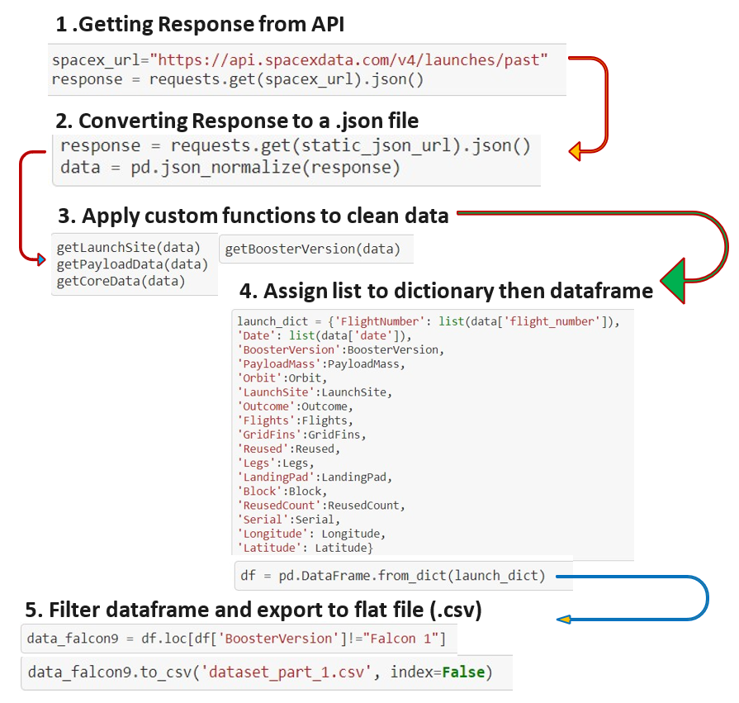
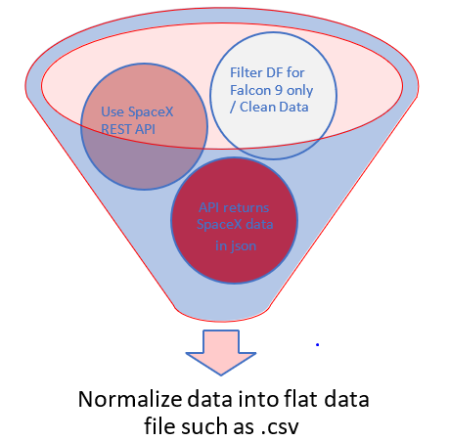
Data Collection – SpaceX API
GitHub Url for Data Collection API

Slide 9
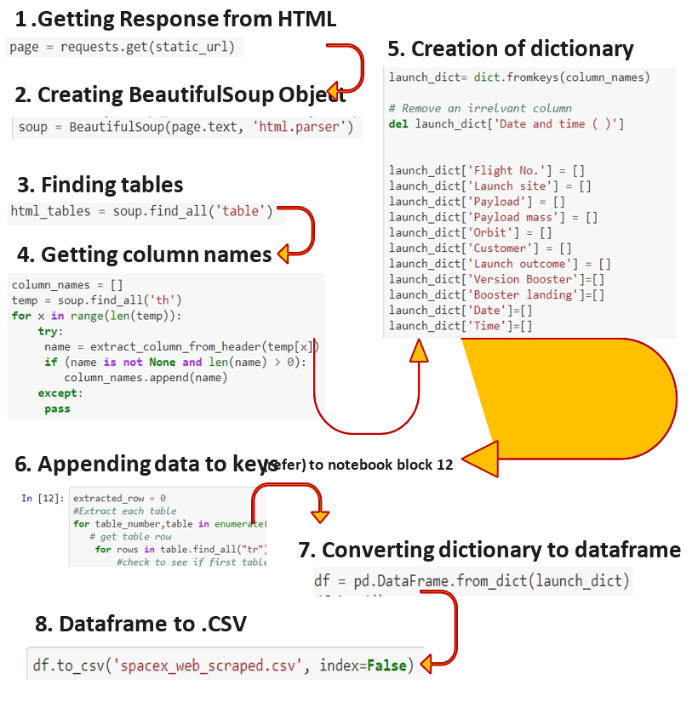
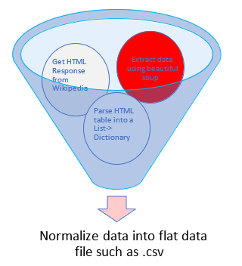
Data Collection - Scraping
GitHub link Data Collection with Web Scraping

Slide 10
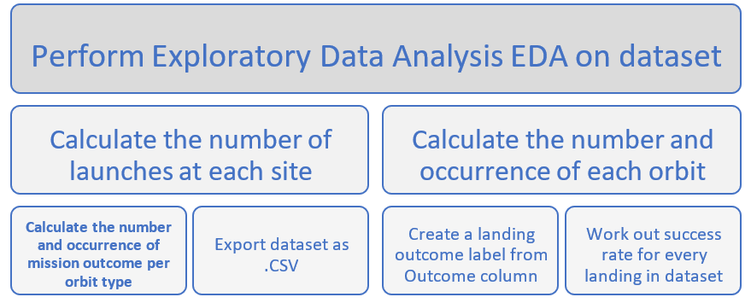
Data Wrangling
In the data set, there are several different cases where the booster did not land successfully. Sometimes a landing was attempted but failed due to an accident; for example, True Ocean means the mission outcome was successfully landed to a specific region of the ocean while False Ocean means the mission outcome was unsuccessfully landed to a specific region of the ocean. True RTLS means the mission outcome was successfully landed to a ground pad False RTLS means the mission outcome was unsuccessfully landed to a ground pad. True ASDS means the mission outcome was successfully landed on a drone ship False ASDS means the mission outcome was unsuccessfully landed on a drone ship.
We mainly convert those outcomes into Training Labels with 1 means the booster successfully landed 0 means it was unsuccessful.
GitHub Link Data wrangling

Slide 11
EDA with Data Visualization
Scatter Graphs being drawn:
Flight Number VS. Payload Mass
Flight Number VS. Launch Site
Payload VS. Launch Site
Orbit VS. Flight Number
Orbit VS. Payload Mass
Payload VS. OrbitType
Scatter plots’ primary uses are to observe and show relationships between two numeric variables. The dots in a scatter plot not only report the values of individual data points, but also patterns when the data are taken as a whole.
Bar Graph being drawn:
Mean VS. Orbit
Bar graphs are used to compare things between different groups or to track changes over time. However, when trying to measure change over time, bar graphs are best when the changes are larger.
Line Graph being drawn:
Success Rate VS. Year
Line graphs are used to track changes over short and long periods of time. When smaller changes exist, line graphs are better to use than bar graphs. Line graphs can also be used to compare changes over the same period of time for more than one group.
GitHub Link Exploring and Preparing Data

Slide 12
EDA with SQL
Performed SQL queries to gather information about the dataset.
Displaying the names of the unique launch sites in the space mission
Displaying 5 records where launch sites begin with the string 'KSC’
Displaying the total payload mass carried by boosters launched by NASA (CRS)
Displaying average payload mass carried by booster version F9 v1.1
Listing the date where the successful landing outcome in drone ship was achieved.
Listing the names of the boosters which have success in ground pad and have payload mass greater than 4000 but less than 6000
Listing the total number of successful and failure mission outcomes
Listing the names of the booster_versions which have carried the maximum payload mass.
Listing the records which will display the month names, successful landing_outcomes in ground pad ,booster versions, launch_site for the months in year 2017
Ranking the count of successful landing_outcomes between the date 2010-06-04 and 2017-03-20 in descending order.
GitHub Link EDA with SQL

Slide 13
Build an Interactive Map with Folium
To visualize the Launch Data into an interactive map. We took the Latitude and Longitude Coordinates at each launch site and added a Circle Marker around each launch site with a label of the name of the launch site.
We assigned the dataframe launch_outcomes(failures, successes) to classes 0 and 1 with Green and Red markers on the map in a MarkerCluster()
Using Haversine’s formula we calculated the distance from the Launch Site to various landmarks to find various trends about what is around the Launch Site to measure patterns. Lines are drawn on the map to measure distance to landmarks
Example of some trends in which the Launch Site is situated in.
Are launch sites in close proximity to railways? No
Are launch sites in close proximity to highways? No
Are launch sites in close proximity to coastline? Yes
Do launch sites keep certain distance away from cities? Yes
GitHub Link Visual Analytics with Folium

Slide 14
Build a Dashboard with Plotly Dash
Dropdown is created to select All launch site or any particular launch site.
Based on dropdown selection pie chart represents success rate of that particular site or all sites.
Dynamic scatter plot between class and payload mass which also changes with dropdown. Payload mass range selector to narrow down the range. Color label is present to distinguish booster version.
Dashboard can be hosted as website, which is useful in sharing the interactive report with anyone with the internet access.
Pie Chart showing the total launches by a certain site/all sites.
Scatter Graph showing the relationship with Outcome and Payload Mass (Kg) for the different Booster Versions
It shows the relationship between two variables.
It is the best method to show you a non-linear pattern.
The range of data flow, i.e. maximum and minimum value, can be determined.
Observation and reading are straightforward.
GitHub Link Dashboard with polydash

Slide 15
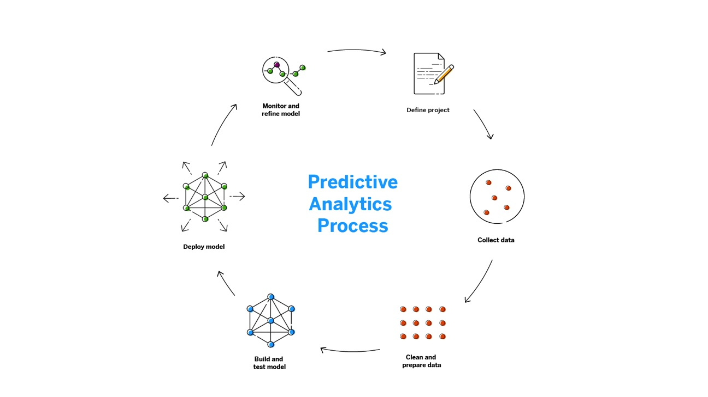
Predictive Analysis (Classification)
BUILDING MODEL
Load our dataset into NumPy and Pandas
Transform Data
Split our data into training and test data sets
Check how many test samples we have
Decide which type of machine learning algorithms we want to use
Set our parameters and algorithms to GridSearchCV
Fit our datasets into the GridSearchCV objects and train our dataset.
EVALUATING MODEL
Check accuracy for each model
Get tuned hyperparameters for each type of algorithms
Plot Confusion Matrix
IMPROVING MODEL
Feature Engineering
Algorithm Tuning
FINDING THE BEST PERFORMING CLASSIFICATION MODEL
The model with the best accuracy score wins the best performing model
In the notebook there is a dictionary of algorithms with scores at the bottom of the notebook.
GitHub Link Machine Learning Prediction

Slide 16
Results
Exploratory data analysis results
Interactive analytics demo in screenshots
Predictive analysis results

Slide 17


Slide 18
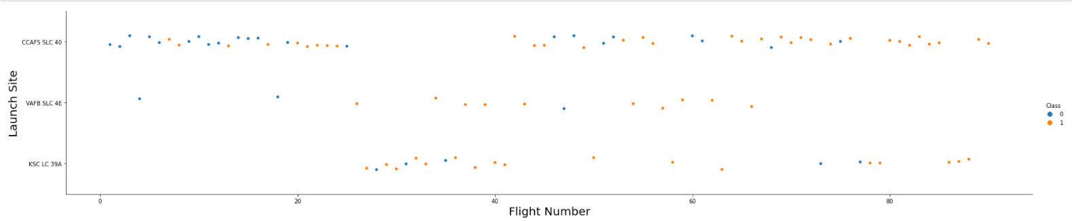
Flight Number vs. Launch Site
The more amount of flights at a launch site the greater the success rate at a launch site.

Slide 19
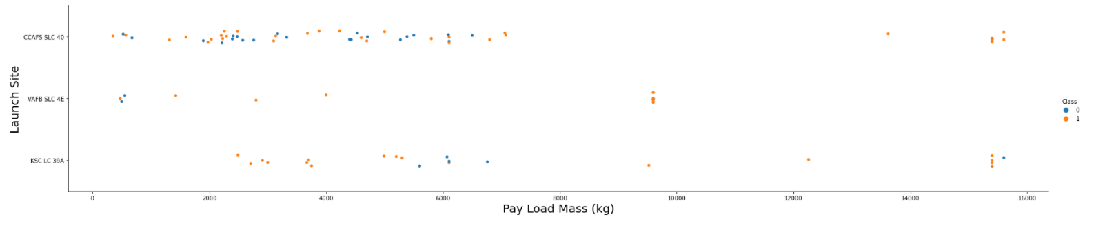
Payload vs. Launch Site
The greater the payload mass higher the success rate for the Rocket.

Slide 20
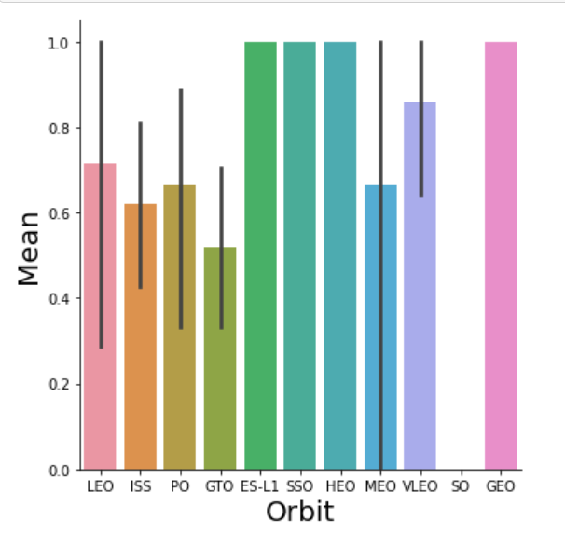
Success Rate vs. Orbit Type
Orbit GEO,HEO,SSO,ES-L1 has the best Success Rate.

Slide 21
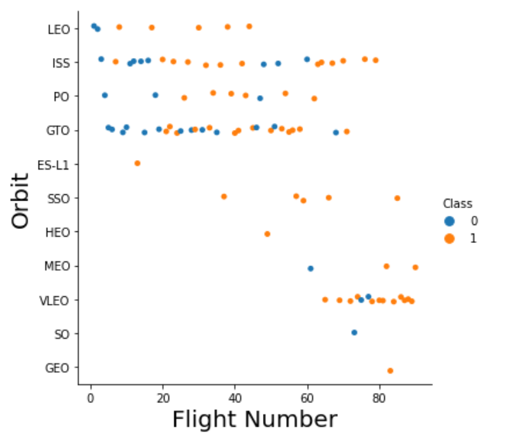
Flight Number vs. Orbit Type
You should see that in the LEO orbit the Success appears related to the number of flights; on the other hand, there seems to be no relationship between flight number when in GTO orbit.

Slide 22
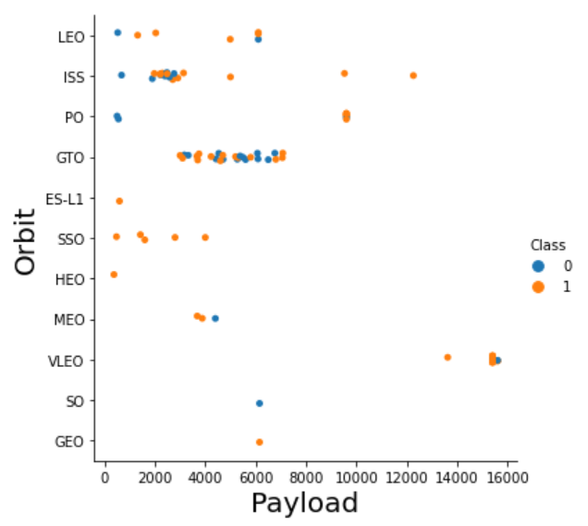
Payload vs. Orbit Type
You should observe that Heavy payloads have a negative influence on GTO orbits and positive on GTO and Polar LEO (ISS) orbits.

Slide 23
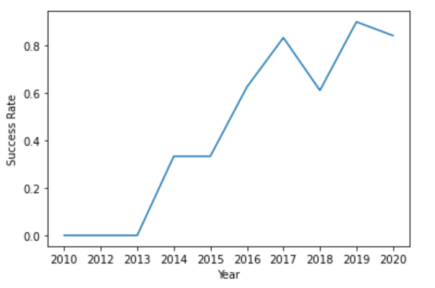
Launch Success Yearly Trend
you can observe that the success rate since 2013 kept increasing till 2020

Slide 24
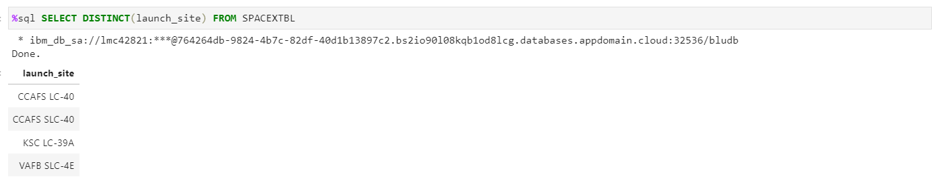
All Launch Site Names
Display the names of the unique launch sites in the space mission

Slide 25
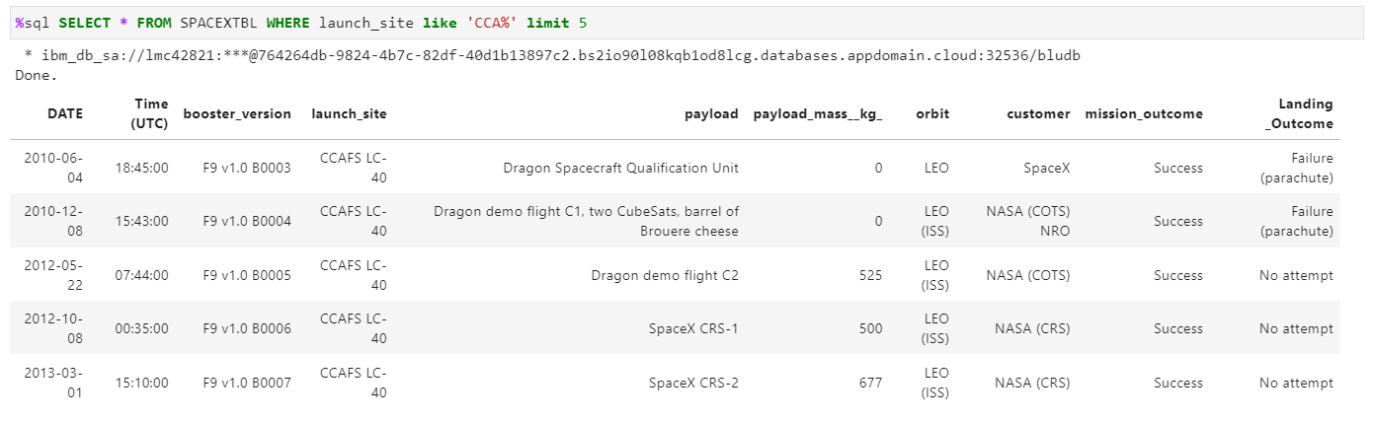
Launch Site Names Begin with 'CCA'
Display 5 records where launch sites begin with the string 'CCA'

Slide 26
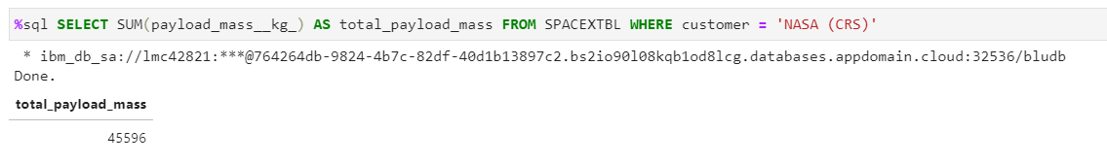
Total Payload Mass
Display the total payload mass carried by boosters launched by NASA (CRS)

Slide 27
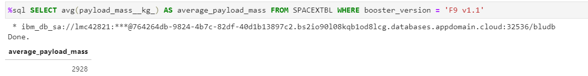
Average Payload Mass by F9 v1.1
Display average payload mass carried by booster version F9 v1.1

Slide 28
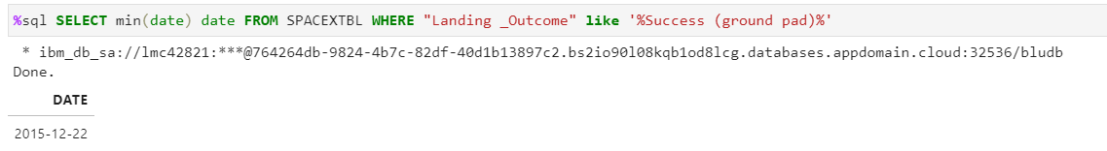
First Successful Ground Landing Date
Find the dates of the first successful landing outcome on ground pad

Slide 29
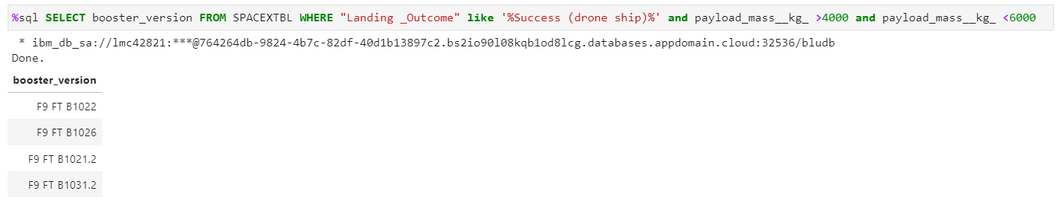
Successful Drone Ship Landing with Payload between 4000 and 6000
List the names of boosters which have successfully landed on drone ship and had payload mass greater than 4000 but less than 6000

Slide 30
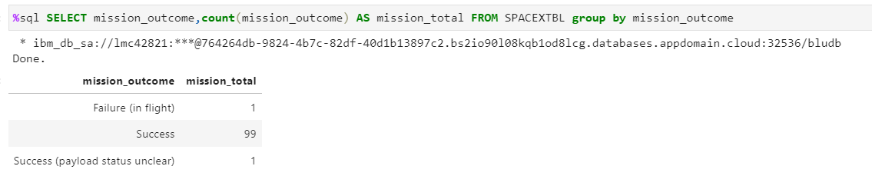
Total Number of Successful and Failure Mission Outcomes
Calculate the total number of successful and failure mission outcomes

Slide 31
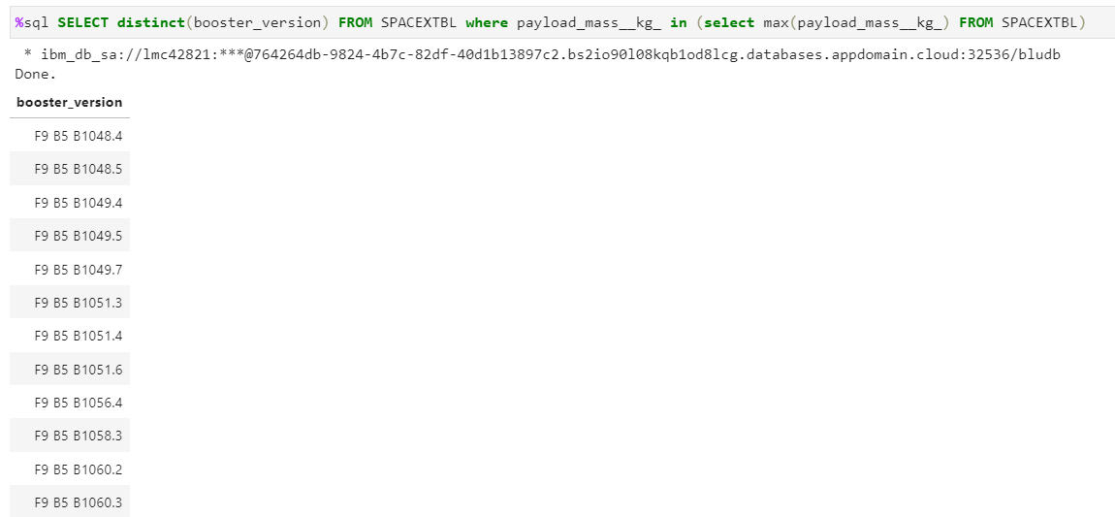
Boosters Carried Maximum Payload
List the names of the booster which have carried the maximum payload mass

Slide 32
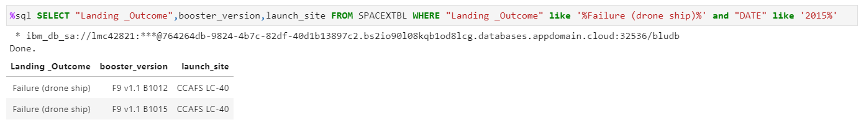
2015 Launch Records
List the failed landing outcomes in drone ship, their booster versions, and launch site names for in year 2015

Slide 33
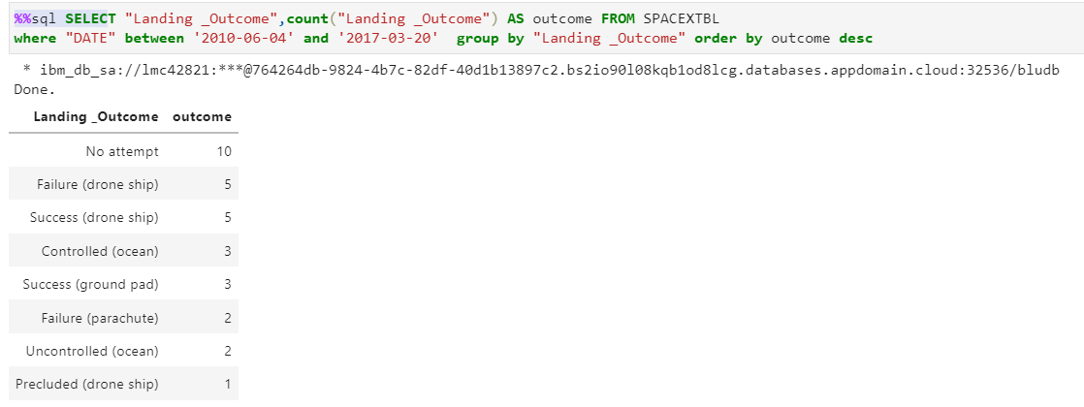
Rank Landing Outcomes Between 2010-06-04 and 2017-03-20
Rank the count of landing outcomes (such as Failure (drone ship) or Success (ground pad)) between the date 2010-06-04 and 2017-03-20, in descending order

Slide 34


Slide 35
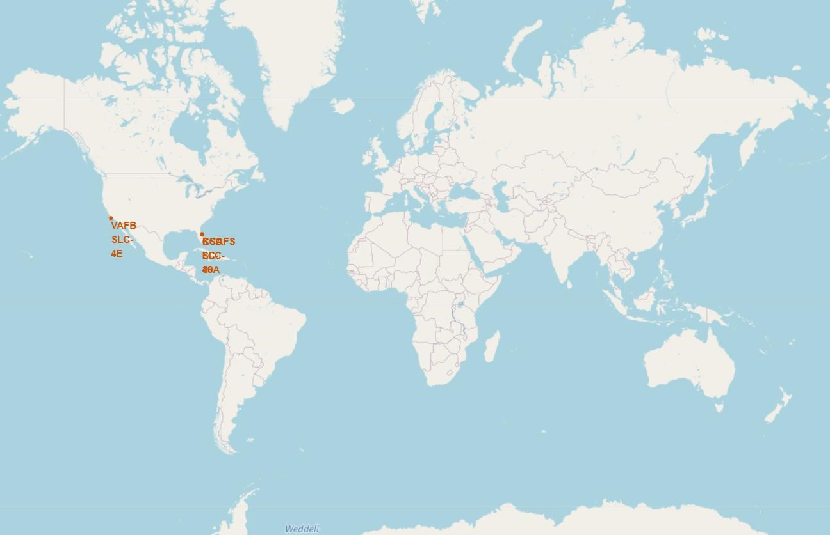
All launch sites global map markers
We can see that the SpaceX launch sites are in the United States of America coasts.

Slide 36
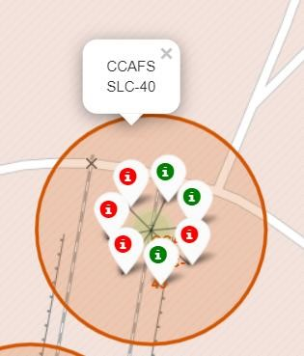
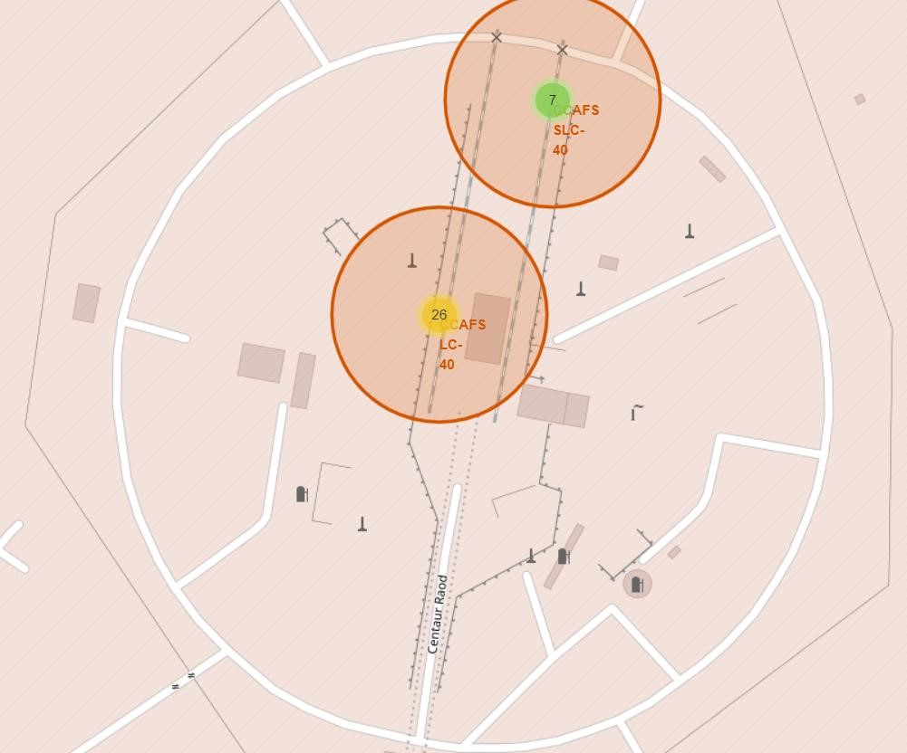
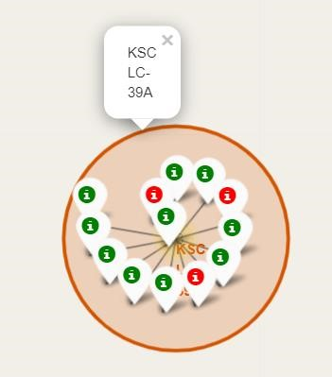
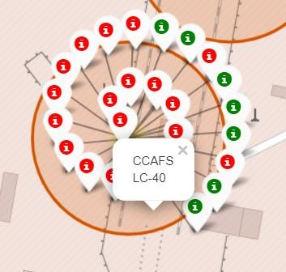
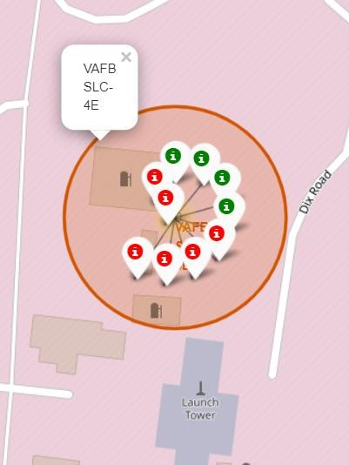
Color Labelled Markers
Green Marker shows successful Launches and Red Marker
shows Failures

Slide 37
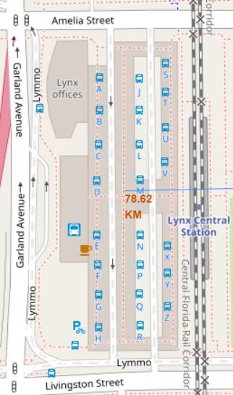
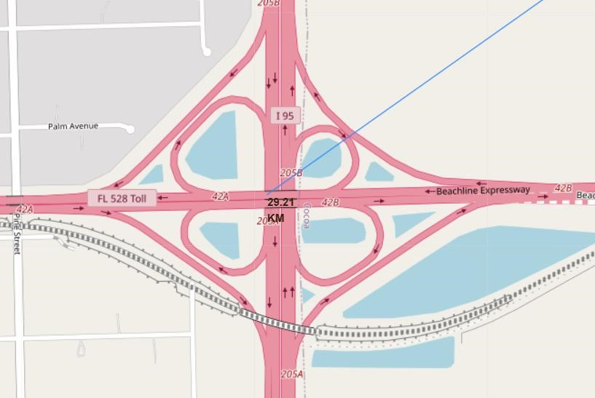
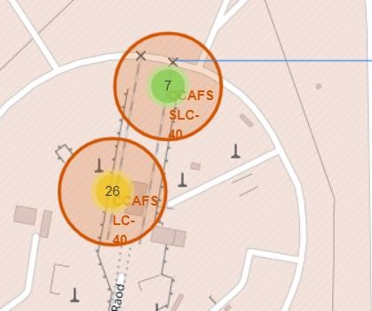
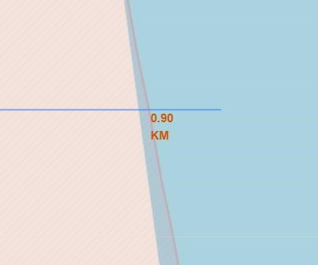
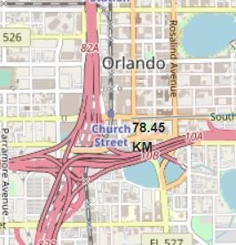
Launch Site Distance from Landmarks
Highway
coast
Are launch sites in close proximity to railways? No
Are launch sites in close proximity to highways? No
Are launch sites in close proximity to coastline? Yes
Do launch sites keep certain distance away from cities? Yes
Railway Station
Coastline
City

Slide 38


Slide 39
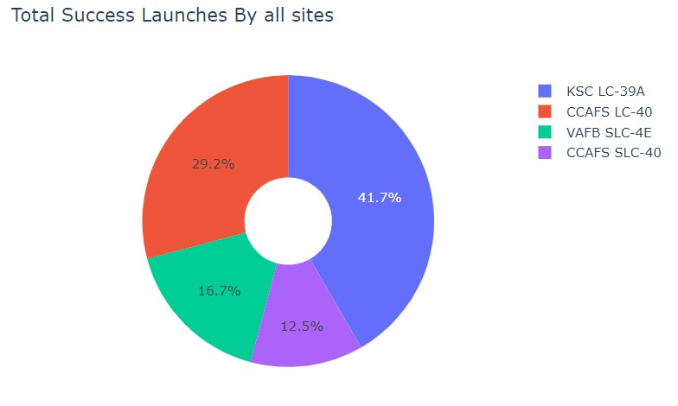
Success Count of All Launch Sites
We can see that KSC LC-39A had the most successful launches from all the sites

Slide 40
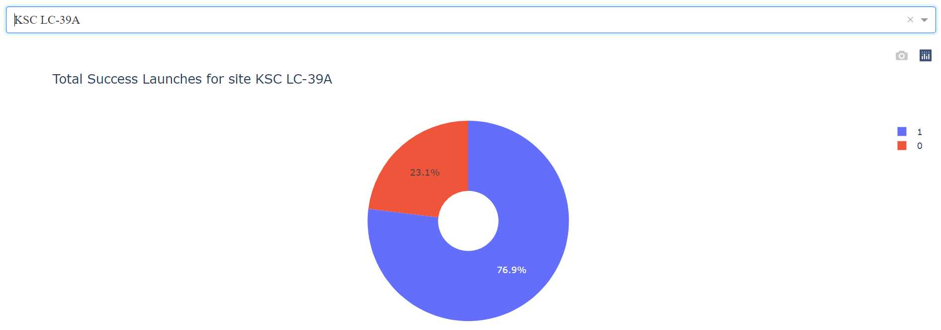
Success Ratio of KSC LC-39A Launch Site
KSC LC-39A achieved a 76.9% success rate while getting a 23.1% failure rate

Slide 41
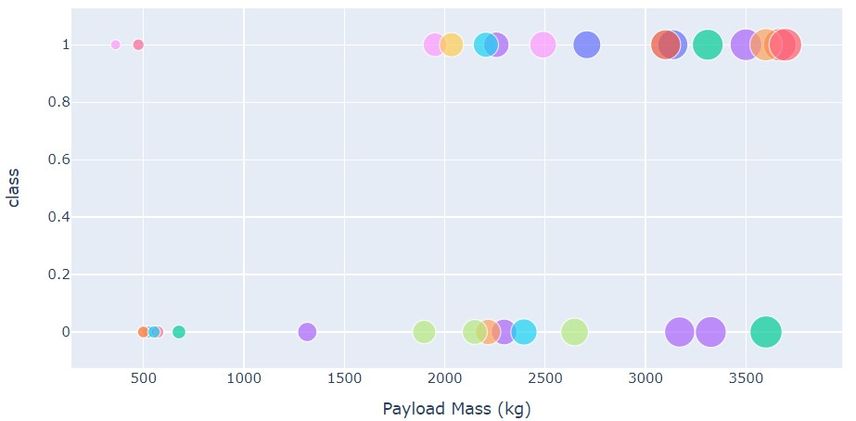
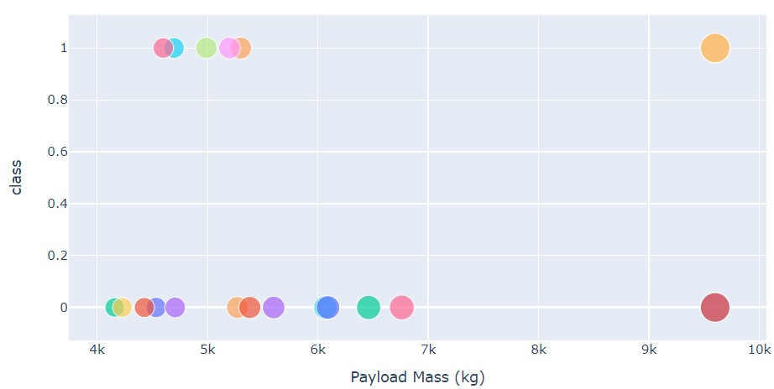
Payload vs. Launch Outcome scatter plot for all sites, with different payload selected in the range
Low Weighted Payload 0kg – 4000kg
Heavy Weighted Payload 4000kg – 10000kg
We can see the success rates for low weighted payloads is higher than the heavy weighted payloads

Slide 42


Slide 43
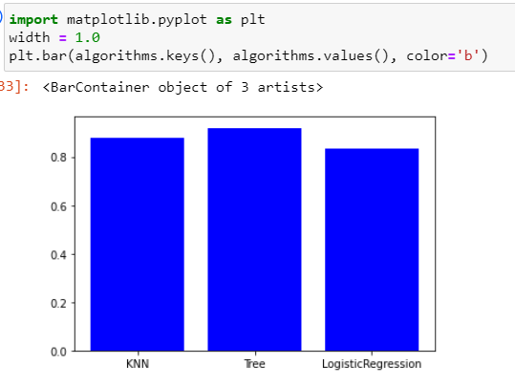
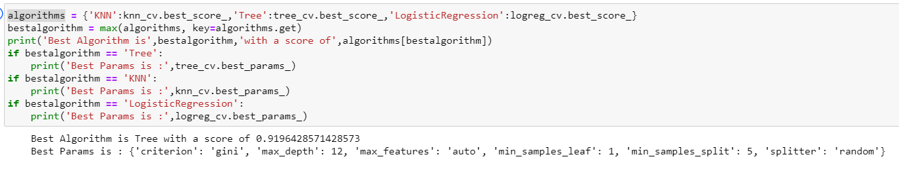
Classification Accuracy
Decision Tree algorithm has the highest train accuracy of 91.96%
After selecting the best hyperparameters for the decision tree classifier using the validation data, we achieved 66.67% accuracy on the test data.

Slide 44
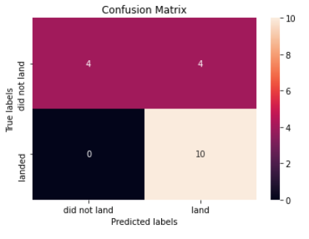
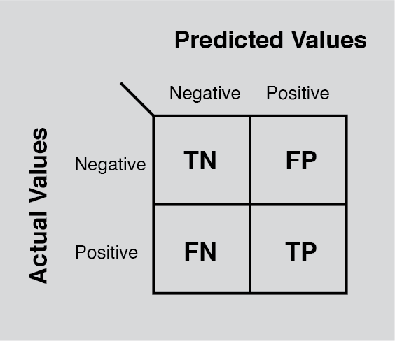
Confusion Matrix
Examining the confusion matrix, we see that Tree can distinguish between the different classes. We see that the major problem is false positives.
The Tree Classifier Algorithm is the best for Machine Learning for this dataset
Low weighted payloads perform better than the heavier payloads

Slide 45
Conclusions
The success rates for SpaceX launches is directly proportional time in years they will eventually perfect the launches.
We can see that KSC LC-39A had the most successful launches from all the sites.
Orbit GEO,HEO,SSO,ES-L1 has the best Success Rate.
Decision Tree Classifier showed promising result with given dataset predicting the success/failure takeoff based on feature parameters.

Slide 46
Appendix
GitHub Repository

Slide 47


